Slide 1
CERT Hazard Annexes

Slide 2
Earthquake
CERT Hazard Annex 2

Slide 3
Introduction (Annex 2)
An earthquake is the sudden, rapid shaking of the earth, caused by the breaking and shifting of subterranean rock as it releases strain that has accumulated over a long time
Usually less than 50 miles below the surface
There is no seasonal or yearly cycle of earthquake occurrence; earthquakes can happen at any time
Many parts of the United States carry significant risk of earthquakes
PM EQ-1
CERT Hazard Annex: Earthquake
EQ-1

Slide 4
Earthquake Impacts
Fatalities
The severity of the shaking during an earthquake can cause manmade and natural structures and the contents within these to fail or fall and injure or kill people
Disruptions
Interrupts transportation, power, and daily life due to collapsed buildings, damages to utilities and roads
Generates economic losses from damages to structures and roadways
PM EQ-1
CERT Hazard Annex: Earthquake
EQ-2

Slide 5
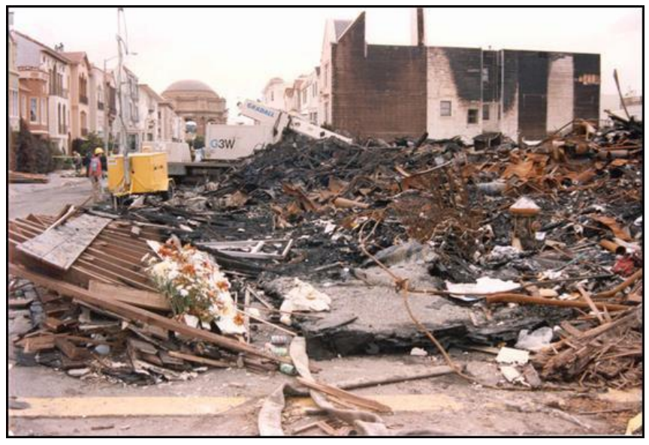
Accompanying Hazards
Earthquakes can trigger other hazards
Avalanches
Fires
Floods
Landslides
Tsunamis
PM EQ-1
CERT Hazard Annex: Earthquake
EQ-3

Slide 6
Earthquake Geography
Many areas of the United States face significant risk from earthquakes. Notable areas include:
Western United States
San Andreas Fault (California)
Cascadia Subduction Zone (Western Oregon and Washington)
Aleutian-Alaska Subduction Zone (Coastal Alaska)
Central United States
New Madrid Fault Zone (Missouri, Arkansas, Tennessee, and Kentucky)
A few pockets on the East Coast
Coastal South Carolina
New England
PM EQ-1
CERT Hazard Annex: Earthquake
EQ-4

Slide 7
Earthquake Magnitude
Earthquake magnitude and intensity can be measured on the Modified Mercalli Intensity Scale, replacing Richter Scale classifications
Magnitude | Typical Maximum Modified Mercali Intensity
1.0 – 3.0 | I
3.0 – 3.9 | II – III
4.0 – 4.9 | IV – V
5.0 – 5.9 | VI – VII
6.0 – 6.9 | VII – IX
7.0 and higher | VII or higher
PM EQ-2
CERT Hazard Annex: Earthquake
EQ-5

Slide 8
Modified Mercalli Intensity Scale (1 of 4)
Not felt except by very few under especially favorable conditions
Felt by a few persons at rest, especially on upper floors of buildings
Felt noticeably by persons indoors, many do not recognize it as an earthquake
Felt indoors by many, outdoors by few; dishes, windows, doors disturbed; walls make cracking sounds
PM EQ-3
CERT Hazard Annex: Earthquake
EQ-6

Slide 9
Modified Mercalli Intensity Scale (2 of 4)
Felt by nearly everyone; many awakened; some dishes, windows broken; unstable objects overturned
Felt by all. Some heavy furniture moved; few instances of fallen plaster; damage slight
Damage negligible in buildings of good design, slight-to-moderate in well-built ordinary structures, considerable damage in poorly built structures
PM EQ-3
CERT Hazard Annex: Earthquake
EQ-7

Slide 10
Modified Mercalli Intensity Scale (3 of 4)
Damage slight in specially designed structures; considerable in ordinary buildings; great in poorly built structures; heavy furniture overturned
Damage considerable in specially designed structures; great in substantial buildings; buildings shifted off foundations
Some well-built wooden structures destroyed; most masonry and frame structures destroyed; rails bent
PM EQ-3
CERT Hazard Annex: Earthquake
EQ-8

Slide 11
Modified Mercalli Intensity Scale (4 of 4)
Few, if any, masonry structures standing; bridges destroyed; rails bent greatly
Damage total; lines of sight and level distorted; objects thrown into air
PM EQ-3
CERT Hazard Annex: Earthquake
EQ-9

Slide 12
Earthquake Preparedness (1 of 3)
Know what to do during an earthquake
Practice how to Drop, Cover, and Hold On
Conduct earthquake drills with your family or coworkers
Develop a family communication plan
Keep supplies on hand (refer to Disaster Supply Kit in CERT Basic Training Unit 1)
PM EQ-4
CERT Hazard Annex: Earthquake
EQ-10

Slide 13
Earthquake Preparedness (2 of 3)
Keep shoes and a flashlight under the bed
Secure bookshelves, water heaters, and tall furniture to wall studs
Install latches on all cabinets, and anchor overhead lighting fixtures
Secure items that might fall, such as televisions
Store heavy and breakable objects on low shelves
PM EQ-4
CERT Hazard Annex: Earthquake
EQ-11

Slide 14
Earthquake Preparedness (3 of 3)
Move beds away from windows
Move or secure hanging objects over beds, couches, and other places where people sit or lie
Have a licensed professional install flexible pipe to avoid gas or water leaks
PM EQ-4
CERT Hazard Annex: Earthquake
EQ-12

Slide 15
During an Earthquake
Drop, cover, and hold on
If indoors: stay there until shaking stops
If outdoors: find a spot away from buildings, trees, streetlights, overpasses, and power lines
If in a vehicle: drive to clear spot and stop
If in bed: stay there and cover head and neck with pillow
PM EQ-4
CERT Hazard Annex: Earthquake
EQ-13

Slide 16
After an Earthquake
Immediately check yourself for injuries and protect yourself from further danger
Check others for injuries and provide assistance if you have training
Look for and extinguish small fires and clean spills
Inspect your home for damage
Tune to the Emergency Alert System
Expect aftershocks
Help neighbors who may require assistance
PM EQ-5
CERT Hazard Annex: Earthquake
EQ-14

Slide 17
Final Questions? (Annex 2)
Additional questions, comments, or concerns about earthquakes?
CERT Hazard Annex: Earthquake
EQ-15

